Slide 1
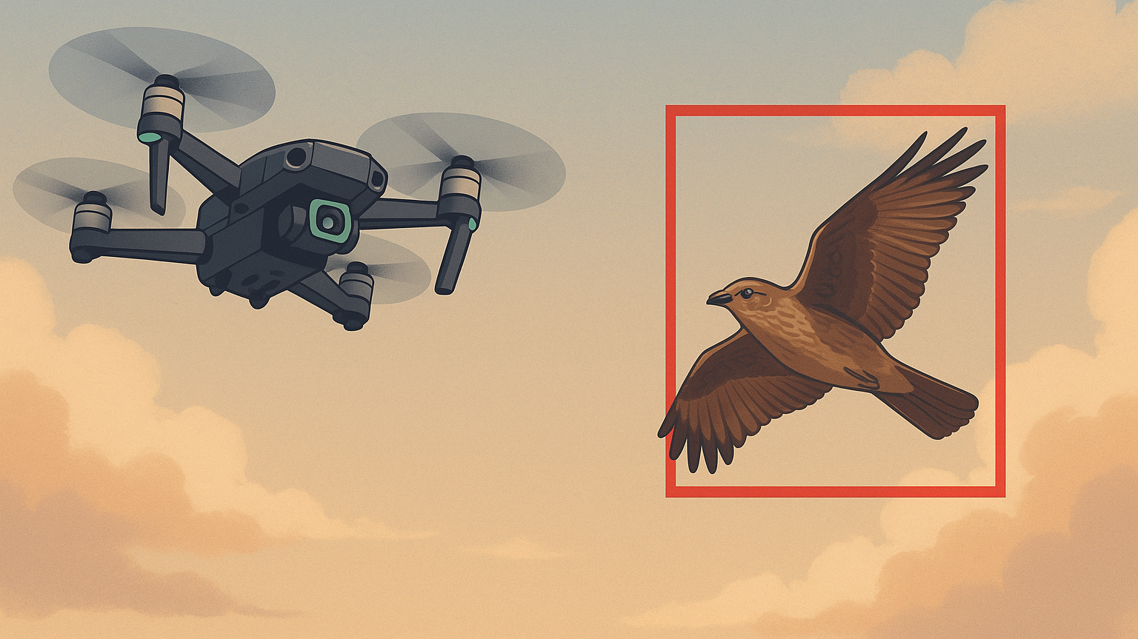
Eyes in the Sky
AI Bird Detection for Drone Safety

Slide 2
Roles and Roadmap
Name | Role | Description
Jordan Capelle | Systems Integration Engineer | Hardware setup & YOLO integration
Karl Garman | Research & Analysis Engineer | Literature review & documentation
Mohomad Sabur | Lead Software Engineer | AI model coding & optimization
Hardware Setup
Code / Train
(November 19th)
Test / Validate
Presentation / Paper
(December 17th)
Notes:
Focuses on Raspberry Pi hardware setup, testing environments, and experimental validation.
Performs literature review, summarizes prior work, and supports documentation.
Designs and implements detection algorithms and optimizes inference on the AI Hat.

Slide 3
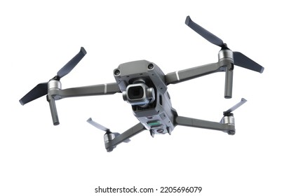
Application Context & Drivers
Rapid growth of sUAS (<55 lb.), especially in BVLOS operations
Main challenge: collision avoidance with other aircraft & ground hazards
Altitude separation limits ground risk (sUAS < 400 ft / Manned > 500 ft)
Networked “sense-and-avoid” improves drone-to-drone safety
Remaining hazard: unpredictable birds capable of disabling drones
Goal: onboard AI bird detection for real-time avoidance
Addresses a research gap in sUAS vision + environmental sensing

Slide 4
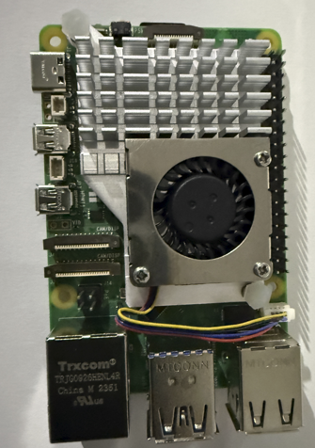
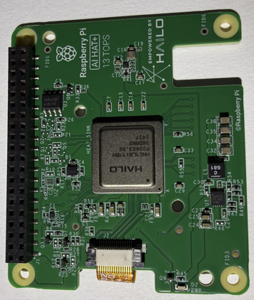
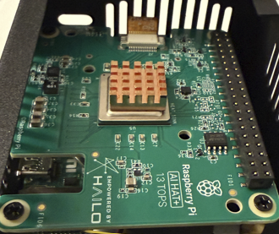
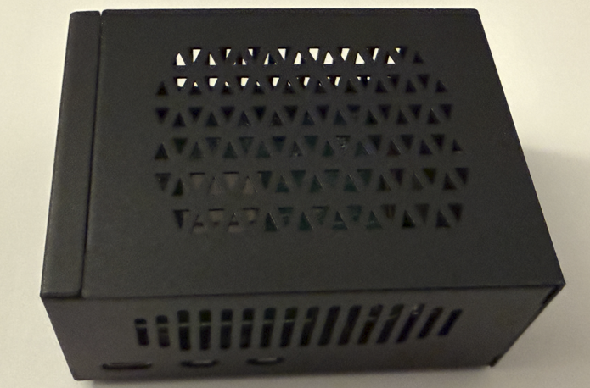
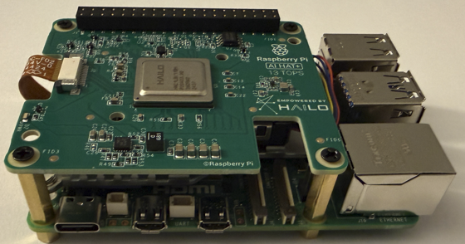
Hardware
Raspberry Pi5 (2.4 -GHz 4 core, 64 bit Arm, 8GB ram, VideoCore VII GPU 800 MHz)
Logitech USB Web Camera – 1080P
Hailo AI Hat – Halio 8L 13 TOPS
Pi5 with active Cooler
Hailo 8L AI Hat 13 TOPS
Pi5 with Hat via PCIe
Heat Sink Hailo 8L Chip
Assembly Enclosure
Build Process

Slide 5
Thank you
Questions?

